Slide 1

CMR COLLEGE OF ENGINEERING & TECHNOLOGY
Kandlakoya, Medchal, Hyderabad - 501401
Department of CSE(Data Science)
MAJOR PROJECT REVIEW-2

Slide 2

  Rasa-Based NLP Chatbot for Disease Awareness and Preventive Healthcare Information: An Offline, Privacy-Focused System for Instant Symptom Recognition and Safe Health Guidance.
Under esteemed guidance of
Mr.K.Sharath Kumar
Assistant. Professor
Dept. of CSE(Data Science)
Name: Roll No:
1. S.Thirumala 23H51A67H6
2. K.BhanuSri 24H55A6709
3. B.Vivek 23H51A67D2

Slide 3
Abstract
Access to reliable healthcare information remains limited in rural and semi-urban areas, leading to delayed diagnosis and poor health awareness. This project develops an AI-powered chatbot that provides instant information about common diseases, symptoms, prevention measures, and nearby healthcare resources. The chatbot uses NLP for intent recognition and entity extraction, built using frameworks like Rasa a custom BERT-based intent classifier, powered by a structured knowledge base of diseases and precautions sourced from WHO/ICMR guidelines. The system supports multi-turn conversations, allowing users to describe symptoms and receive probable disease information along with a recommendation to consult a doctor (avoiding direct diagnosis for safety). Multilingual support is incorporated using translation APIs to make the chatbot accessible to non-English speaking users, a critical requirement for rural outreach. The chatbot is deployed via a web interface and can be integrated with messaging platforms like WhatsApp or Telegram for wider accessibility. The backend uses Python with Rasa for NLU, while the frontend is a chat widget built with React or a Telegram bot API integration. User interactions are logged with privacy safeguards to continuously improve intent recognition accuracy. Evaluation metrics include intent classification accuracy and response relevance. This project showcases skills in conversational AI and NLP pipelines, highly valued in AI/ML placements and reflecting real-world social impact.

Slide 4
Introduction
Access to reliable healthcare information remains limited in rural and semi-urban areas, leading to delayed diagnosis and poor health awareness.
HealthBot AI provides an AI-powered chatbot for instant disease awareness, covering common symptoms, precautions, and doctor-consultation guidance.
The system models a structured knowledge base of 41 diseases, each mapped to symptoms, precautions, and medical advice.
It analyzes user-described symptoms using NLP-based intent recognition and entity extraction to identify likely disease matches.
AI-powered response generation delivers safe, non-diagnostic health guidance while always recommending professional consultation.
An interactive chat interface provides users with clear, instant insights into possible conditions, precautions, and next steps.

Slide 5
Literature Survey
REFERENCE : Exploring the Impact of Large Language Models on Disease Diagnosis
Author Name(s): IBRAHIM ALMUBARK Department of Information Technology, College of Computer, Qassim University, Buraydah 52571, Saudi Arabia .This work was supported by the Deanship of Graduate Studies and Scientific Research at Qassim University under Grant QU-APC-2024.
Title of the Paper: Exploring the Impact of Large Language Models on Disease Diagnosis Journal Name: IEEE
Volume No.: 13
Year: 2025
Observation: This paper introduces an AI-driven public health chatbot, a scenario-based conversational system for delivering instant disease awareness and symptom guidance. It uses natural language understanding, symptom-to-disease matching, and a structured 41-disease knowledge base to identify probable conditions and recommend appropriate precautions. The system demonstrates that NLP-based symptom analysis can provide more accessible and immediate health awareness than traditional information sources, particularly for rural and semi-urban populations, while consistently directing users toward professional medical consultation rather than replacing it.
.

Slide 6
Literature Survey
REFERENCE : A Conversation-Driven Approach for Chatbot Management .
Author Name(s): GIOVANNI ALMEIDA SANTOS GEOVANA RAMOS SOUSA SILVA 1,(Member, IEEE), GUILHERME GUY DE ANDRADE 1,FRANCISCO CARLOS MOLINA DUARTE, JR. JOÃO PAULO JAVIDI DA COSTA 3,(Senior Member, IEEE), AND RAFAEL TIMÓTEO DE SOUSA, JR. 1,(Senior Member, IEEE).
Title of the Paper: A Conversation-Driven Approach for Chatbot Management.
Journal Name: IEEE
Year: 2022
Observation: This paper introduces the Chatbot Management Process (CMP), a conversation-driven methodology for post-deployment chatbot content management. It uses a cyclic three-phase approach — manage, build, and analyze — combined with human-supervised learning and performance metrics to evolve knowledge bases based on real user conversations. The framework demonstrates that structured, conversation-driven content management can significantly reduce human hand-off rates and grow chatbot knowledge bases while maintaining response confidence and user satisfaction, validated through the deployment of the EvaTalk chatbot.

Slide 7
Literature Survey
REFERENCE : Toward Inclusive Healthcare: An LLM-Based Multimodal Chatbot for Preliminary Diagnosis
Author Name(s): ISHITA AGARWAL , V. SAKTHIVEL , (Member, IEEE), AND P. PRAKASH School of Computer Science and Engineering, Vellore Institute of Technology, Chennai, Tamil Nadu 600127, India Corresponding author: V. Sakthivel. This work was supported by Vellore Institute of Technology, Chennai, India
Title of the Paper: Toward Inclusive Healthcare: An LLM-Based Multimodal Chatbot for Preliminary Diagnosis
Journal Name: IEEE
Year: 2025
Observation: This paper introduces an LLM-based multimodal medical chatbot, a Retrieval-Augmented Generation (RAG) framework for preliminary disease diagnosis using text and image inputs. It uses Gemini-2.0-Flash, a FAISS vector database, and a curated 1,613-topic medical knowledge base to retrieve relevant information and generate grounded, context-aware responses. The framework demonstrates that RAG-based retrieval can provide more accurate and less hallucinated diagnostic insights than direct LLM querying alone, and can support accessible, scalable preliminary healthcare guidance for underserved populations.

Slide 8
Problem Statement
Many people, especially in rural and semi-urban areas, don't have quick or easy access to a doctor. Existing health websites and pamphlets only give general information and can't understand a person's specific symptoms. Because of this, people often ignore early symptoms or don't know what precautions to take, which can lead to delayed diagnosis and worse health outcomes over time. This project solves this by building an AI-powered chatbot that understands symptoms described in plain language, instantly provides information about possible diseases and useful precautions, and gives clear guidance on when to see a doctor.

Slide 9
Existing Solutions
Rule-Based Chatbots – Older medical chatbots used simple predefined rules to match symptoms to diseases. They could handle basic conversations but struggled if a user phrased something differently than expected, since they couldn't understand language flexibly.
AI Chatbots Using Large Language Models (like ChatGPT, GPT-4, BARD) – These systems use powerful AI models trained on huge amounts of text to diagnose diseases from symptoms, medical records, and even images. The problem is they sometimes "hallucinate" — meaning they confidently give wrong or made-up medical information — and it's hard to understand how they arrived at their answer.
RAG-Based Chatbots (AI + Verified Knowledge Search) – Newer systems combine AI models with a real, trusted medical database (like WebMD), so instead of guessing, the chatbot looks up verified information before answering. This reduces wrong answers, but it needs a lot of computing power, internet access, and careful handling of user privacy.
Chatbot Management Systems – Some approaches focus not on the AI itself, but on how a chatbot's knowledge is kept updated over time by studying real conversations with users. This helps the chatbot improve gradually, but it needs a dedicated team constantly reviewing and updating the system.

Slide 10
Proposed Solution
Symptom-Based Conversational Interface: Lets users describe their symptoms in plain, everyday language instead of filling out complicated forms.
Intent & Entity Recognition (NLP): Understands what the user is asking (greeting, describing symptoms, asking for prevention tips) and automatically extracts specific symptoms from their message.
Disease Knowledge Base: Stores structured information on 41 diseases, including their symptoms, precautions, and doctor-consultation advice.
Symptom-to-Disease Matching: Compares extracted symptoms against the knowledge base to identify the most likely disease(s), even when multiple conditions share similar symptoms.
Safety-First Disclaimers: Every response reminds the user that this is not a medical diagnosis and encourages them to consult a doctor for serious or persistent symptoms.
Ambiguity Handling: If symptoms match more than one disease equally, the chatbot lists all possibilities instead of guessing incorrectly.
Fallback for Vague Input: If a user's message doesn't contain clear symptoms, the chatbot asks a clarifying question instead of giving a wrong answer.
Instant, Accessible Guidance: Provides users with immediate health awareness and next steps, especially useful for people in rural or semi-urban areas with limited access to doctors.

Slide 11
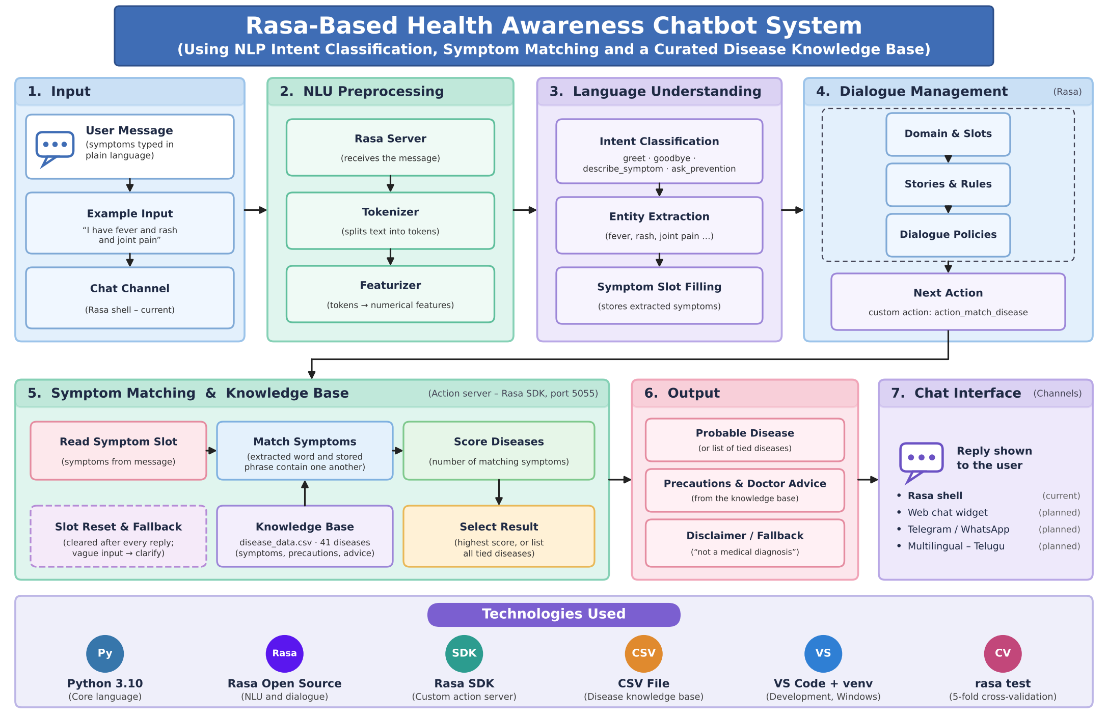
Design

Slide 12
Methodology
Data collection: Example sentences are written for four intents (greet, goodbye, describe_symptom, ask_prevention). A knowledge base of 41 diseases, with symptoms, precautions and doctor advice, is compiled from public data into a CSV file.
Data preprocessing: Symptoms are annotated as entities, synonyms are normalised, duplicate examples are removed, and every disease record follows one format.
NLU model training: The Rasa pipeline tokenises and featurises each message, then predicts the intent and extracts the symptoms. The symptoms are stored in a slot.
Symptom-to-disease matching: A custom Python action scores each disease by the number of matching symptoms and returns the top one. If several diseases tie, it lists all of them.
Safe response and evaluation: Every reply ends with a disclaimer, vague input gets a fallback, and the symptom slot is cleared after each reply. The NLU model is evaluated with five-fold cross-validation using rasa test.

Slide 13
Implementation
Environment: Python 3.10 in a virtual environment, with Rasa and Rasa SDK, developed in VS Code on Windows.
Project files: nlu.yml (training data), domain.yml and rules.yml (replies and dialogue), disease_data.csv (knowledge base), actions/actions.py (matching logic) and endpoints.yml (server link).
Custom action: action_match_disease loads the CSV, matches the extracted symptoms to each disease, picks the highest score or lists the ties, adds the disclaimer and resets the slot.
Running the system: The action server starts first (rasa run actions, port 5055), then the chat starts (rasa shell). endpoints.yml connects the two.
Testing and fixes: Dengue and Common Cold messages were tested in the Rasa shell. The missing action endpoint and symptoms carrying over between messages were fixed. Cross-validation gave about 99% intent accuracy and about 97% symptom extraction, so quote the exact values from your results folder.

Slide 14
References
I.Agarwal, V. Sakthivel, and P. Prakash, “Toward inclusive healthcare: An LLM-based multimodal chatbot for preliminary diagnosis,” IEEE Access, vol. 13, 2025, doi: 10.1109/ACCESS.2025.3594218.
I.Almubark, “Exploring the impact of large language models on disease diagnosis,” IEEE Access, vol. 13, pp. 8225–8238, 2025, doi: 10.1109/ACCESS.2025.3527025.
B. Pradhan, S. Das, D. S. Roy, S. Routray, F. Benedetto, and R. H. Jhaveri, “An AI-assisted smart healthcare system using 5G communication,” IEEE Access, vol. 11, pp. 108339–108355, 2023, doi: 10.1109/ACCESS.2023.3317174.
G. A. Santos, G. G. de Andrade, G. R. S. Silva, F. C. M. Duarte Jr., J. P. J. da Costa, and R. T. de Sousa Jr., “A conversation-driven approach for chatbot management,” IEEE Access, vol. 10, pp. 8474–8486, 2022, doi: 10.1109/ACCESS.2022.3143323.
T. Bocklisch, J. Faulkner, N. Pawlowski, and A. Nichol, “Rasa: Open source language understanding and dialogue management,” arXiv preprint arXiv:1712.05181, 2017.

Slide 15
THANK YOU!!!

